Slide 1
Data Mining & Warehousing
Implementations
By
Prof.Dr. O.P.Vyas
IIIT- A

Slide 2
D.M.W.
Data Mining
  DM Functionalities-Association Rule Mining: Apriori Algorithm
  Issues in DM : User-Centric Vs Procedure centric
    Apriori Vs FP Tree
    Rare item Problem: Single MinSup problem
  Classification & Predictive mechanism
    Classification with Tree Classifiers
    Predictive Accuracy and various classifiers: DTC & Random Forests
    Bayesian Classifiers & Laplacian correction: Bayesian Belief Networks
  Overview : Clustering Analysis
ANN & Deep Learning Paradigm
  Artificial Systems Vs Biological Systems
  Artificial Neural Network Vs Conventional systems
  Feedforwards & Backpropagation
    Multilayer Feedforward Neural Network
    Backpropagation Algorithm
      Working mechanism- Weights, Bias & Activation Function
  Deep Learning Paradigm & CNN

Slide 3
Artificial systems Vs. Biological systems
Designers of artificial systems – both hardware and software, whether engineering systems, computer systems, or business systems-can only marvel at the robustness, the efficiency, and the flexibility of biological systems.
The central theme of research on many Soft Computing approaches like ANN & GAs has been robustness for survival in many different environments. The implications of robustness for artificial systems are manifold.
  If artificial systems can be made more robust, costly redesigns can be reduced or eliminated.
Feature for self-repair, self-guidance, and re-production are the rule in biological systems, whereas they barely exist in the most sophisticated systems.
Notes:
Ranjana vyas

Slide 4
Classification with ANN
In Freud’s theory of psychodynamics, the human brain (~10 ^ 11) was described as a neural network, and investigations have corroborated this view.
This analogy therefore offers an interesting model for the creation of more complex learning machines, and has led the creation of ANN.
  Backpropagation has been considered as effective mechanism in field of classification. The backpropagation algorithm was presented by Rumelhart, Hinton, and Williams.
One of the most popularly used backpropagation technique is a neural network learning algorithm.
Notes:
Ranjana vyas

Slide 5
Neural network, with their remarkable ability to derive meaning from complicated or imprecise data, can be used to extract patterns and detect trends that are too complex to be noticed by either humans or other computer techniques.
A trained neural network can be thought of as an "expert" in the category of information it has been given to analyze.
This expert can then be used to provide projections given new situations of interest and answer "what if" questions.

Slide 6
Neural Networks: Working
An Artificial Neural Network (ANN) is an information processing paradigm that is inspired by the way biological nervous systems, such as the brain, process information.
The key element of this paradigm is the novel structure of the information processing system.
It is composed of a large number of highly interconnected processing elements (neurones) working in unison to solve specific problems. ANNs, like people, learn by example.
An ANN is configured for a specific application, such as pattern recognition or data classification, through a learning process.
Learning in biological systems involves adjustments to the synaptic connections that exist between the neurones. This is true of ANNs as well.
Notes:
Ranjana vyas

Slide 7
ANN Advantages
Adaptive learning: An ability to learn how to do tasks based on the data given for training or initial experience.
Self-Organisation: An ANN can create its own organization or representation of the information it receives during learning time.
Real Time Operation: ANN computations may be carried out in parallel, and special hardware devices are being designed and manufactured which take advantage of this capability.
Fault Tolerance via Redundant Information Coding: Partial destruction of a network leads to the corresponding degradation of performance. However, some network capabilities may be retained even with major network damage.

Slide 8
ANN Vs Conventional Computing approach
Neural networks take a different approach to problem solving than that of conventional computers. Conventional computers use an algorithmic approach i.e. the computer follows a set of instructions in order to solve a problem.
Unless the specific steps that the computer needs to follow are known the computer cannot solve the problem. That restricts the problem solving capability of conventional computers to problems that we already understand and know how to solve. But computers would be so much more useful if they could do things that we don't exactly know how to do.
Neural networks process information in a similar way the human brain does. The network is composed of a large number of highly interconnected processing elements ( neurones) working in parallel to solve a specific problem. Neural networks learn by example. They cannot be programmed to perform a specific task.
The examples must be selected carefully otherwise useful time is wasted or even worse, the network might be functioning incorrectly. The disadvantage is that because the network finds out how to solve the problem by itself, its operation can be unpredictable.

Slide 9
ANN Vs. Conventional…
On the other hand, conventional computers use a cognitive approach to problem solving; the way the problem is to solved must be known and stated in small unambiguous instructions.
These instructions are then converted to a high level language program and then into machine code that the computer can understand.
These machines are totally predictable; if anything goes wrong is due to a software or hardware fault.
Neural networks and conventional algorithmic computers are not in competition but complement each other.
There are tasks, more suited to an algorithmic approach like arithmetic operations and tasks that are more suited to neural networks. Even more, a large number of tasks, require systems that use a combination of the two approaches (normally a conventional computer is used to supervise the neural network) in order to perform at maximum efficiency.
Artificial Neural Networks (ANN) have many different coefficients, which it can optimize. Hence, it can handle much more variability as compared to traditional models.
.

Slide 10
ANN: An engineering approach
A simple neuron
An artificial neuron is a device with many inputs and one output.
The neuron has two modes of operation; the training mode and the using mode.
In the training mode, the neuron can be trained to fire (or not), for particular input patterns.
In the using mode, when a taught input pattern is detected at the input, its associated output becomes the current output.
If the input pattern does not belong in the taught list of input patterns, the firing rule is used to determine whether to fire or not.

Slide 11
Classification by Backpropopagation
Multilayer Feed-forward Neural Network
Backpropagation Algorithm

Slide 12
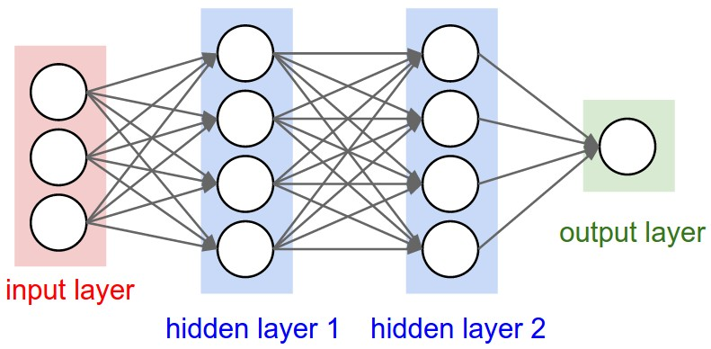
ANN Layers
The commonest type of artificial neural network consists of three groups, or layers, of units: a layer of "input" units is connected to a layer of "hidden" units, which is connected to a layer of "output" units.
The activity of the input units represents the raw information that is fed into the network.
The activity of each hidden unit is determined by the activities of the input units and the weights on the connections between the input and the hidden units.
The behavior of the output units depends on the activity of the hidden units and the weights between the hidden and output units.
This simple type of network is interesting because the hidden units are free to construct their own representations of the input. The weights between the input and hidden units determine when each hidden unit is active, and so by modifying these weights, a hidden unit can choose what it represents.

Slide 13
Neural Networks are like a Black Box
How can I understand what the backpropagation network has learned?
Acquired knowledge in the form of a network of units connected by a weighted links is difficult for humans to interpret.

Slide 14
Network Training
The ultimate objective of training
  obtain a set of weights that makes almost all the tuples in the training data classified correctly
Steps
  Initialize weights with random values
  Feed the input tuples into the network one by one
  For each unit
    Compute the net input to the unit as a linear combination of all the inputs to the unit
    Compute the output value using the activation function
    Compute the error
    Update the weights and the bias
Notes:
Ranjana vyas

Slide 15
Artificial Neural Network: ANN
-
μ_{k}
x₀
w₀
x₁
w₁
∑
f
Output y
x_{n}
w_{n}
Activation
function
Input
vector x
weight
vector w
weighted
sum
The n-dimensional input vector x is mapped into variable y by means of the scalar product and a nonlinear function mapping
Notes:
Ranjana vyas

Slide 16
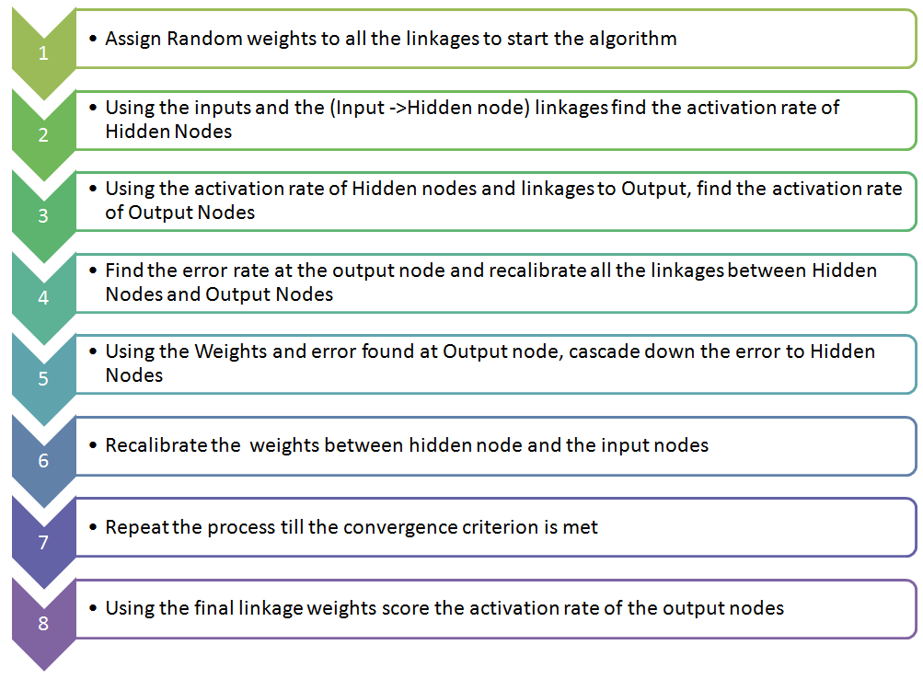
Following is the framework in which Artificial Neural Networks (ANN) work:

Slide 17
ANN
There are different architectures for Neural networks, and they each utilize different wiring and learning strategies.
Advantages
  prediction accuracy is generally high
  robust, works when training examples contain errors
  output may be discrete, real-valued, or a vector of several discrete or real-valued attributes
  fast evaluation of the learned target function
Criticism
  long training time
  difficult to understand the learned function (weights)
  not easy to incorporate domain knowledge Ex Health Care domain with Business Data domain

Slide 18
ANN: Feedforward & Feedback Networks
Paradigm change with Deep Learning

Slide 19
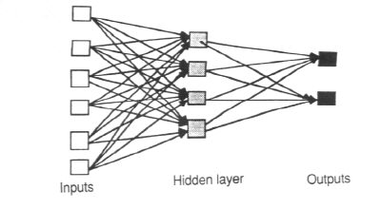
Architecture of Neural Networks
Feed-forward networks
Feed-forward ANNs (figure below) allow signals to travel one way only; from input to output.
There is no feedback (loops) i.e. the output of any layer does not affect that same layer. Feed-forward ANNs tend to be straight forward networks that associate inputs with outputs.
They are extensively used in pattern recognition. This type of organization is also referred to as bottom-up or top-down.

Slide 20
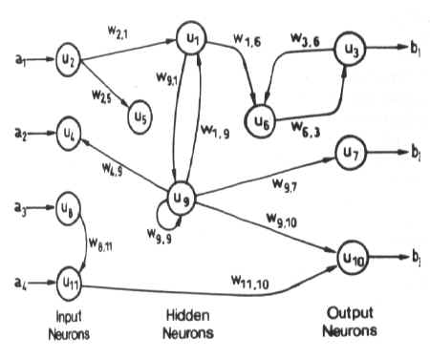
Feedback Networks : Architecture
Feedback networks can have signals traveling in both directions by introducing loops in the network.
Feedback networks are very powerful and can get extremely complicated. Feedback networks are dynamic; their 'state' is changing continuously until they reach an equilibrium point.
They remain at the equilibrium point until the input changes and a new equilibrium needs to be found. Feedback architectures are also referred to as interactive or recurrent, although the latter term is often used to denote feedback connections in single-layer organizations.

Slide 21
Following is the framework in which Artificial Neural Networks (ANN) work:

Slide 22
Applications of ANN
Classification : A neural network can discover the distinguishing features needed to perform a classification task. It can take an object and accordingly assign the specific class label to it.ANN have been used in many classification tasks including;
        Recognition of printed or handwritten characters.
        Classification of SONAR & RADAR signals.
Speech recognition: A very significant area of interest involves three modules namely front end-which samples the speech signals and extracts the data, the word processor which is used for finding the probability of words in the vocabulary that match the features of spoken words and the sentence processor which determines if the recognized word makes sense in the sentence.

Slide 23
Algorithm: Backpropagation. Neural network learning for classification or numeric prediction.
Input: D, a data set consisting of the training tuples and their associated target values; l, the learning rate; network, a multilayer feed-forward network.
Output: A trained neural network.

Slide 24
Perceptron
The perceptron is a type of artificial neural network invented in 1957 at the Cornell Aeronautical Laboratory by Frank Rosenblatt.
It can be seen as the simplest kind of feedforward neural network: a linear classifier.
Although the perceptron initially seemed promising, it was eventually proved that perceptrons could not be trained to recognise many classes of patterns.
This led to the field of neural network research stagnating for many years, before it was recognised that a feedforward neural network with two or more layers (also called a multilayer perceptron) had far greater processing power than perceptrons with one layer (also called a single layer perceptron).
Single layer perceptrons are only capable of learning linearly separable patterns; in 1969 a famous book entitled Perceptrons by Marvin Minsky and Seymour Papert showed that it was impossible for these classes of network to learn an XOR function.
However, this is not true, as both Minsky and Papert already knew that multi-layer perceptrons were capable of producing an XOR Function.

Slide 25
Perceptron
Three years later Stephen Grossberg published a series of papers introducing networks capable of modeling differential, contrast-enhancing and XOR functions. (The papers were published in 1972 and 1973, see e.g.: Grossberg, Contour enhancement, short-term memory, and constancies in reverberating neural networks. Studies in Applied Mathematics, 52 (1973), 213-257, online.
The Minsky/Papert text caused a significant decline in interest and funding of neural network research. It took ten more years until neural network research experienced a resurgence in the 1980s. This text was reprinted in 1987 as "Perceptrons - Expanded Edition" where some errors in the original text are shown and corrected.
Interest in the perceptron learning algorithm increased again after Freund and Schapire (1998) showed that presented a voted formulation of the original algorithm (attaining a large margin) to which the kernel trick can be applied.
Subsequent studies have shown its applicability to a class of more complex tasks, later called as structured learning, than binary classification (Collins, 2002), and to large-scale machine learning problems in a distributed computing setting (McDonald, 2010).

Slide 26
Feedback Network : Backpropagation
The backpropagation algorithm was originally introduced in the 1970s, but its importance wasn't fully appreciated until a famous 1986 paper by David Rumelhart, Geoffrey Hinton, and Ronald Williams.
  The Paper describes several neural networks where backpropagation works far faster than earlier approaches to learning, making it possible to use neural nets to solve problems which had previously been insoluble.
  Today, the backpropagation algorithm is the workhorse of learning in neural networks.
The goal of any supervised learning algorithm is to find a function that best maps a set of inputs to their correct output.
The motivation for backpropagation is to train a multi-layered neural network such that it can learn the appropriate internal representations to allow it to learn any arbitrary mapping of input to output.

Slide 27

ANN Architecture
Bias
-
x₀
w₀
x₁
w₁
∑
f
output y
x_{n}
w_{n}
Activation
function
Input
vector x
weight
vector w
weighted
sum
The n-dimensional input vector x is mapped into variable y by means of the scalar product and a nonlinear function mapping
Notes:
Ranjana vyas

Slide 28
Backpropagation Method:
(1) Initialize all weights and biases in network;
(2) while terminating condition is not satisfied {
(3) for each training tuple X in D { (4)// Propagate the inputs forward:
(5) for each input layer unit j {
(6) Oj = Ij ; // output of an input unit is its actual input value
(7) for each hidden or output layer unit j {
(8) Ij = SigmaSum i wij Oi + θj ; //compute the net input of unit j with respect to the previous layer, i
(9) O = 1 / 1+e−Ij // ;} //compute the output of each unit j
(10) // Backpropagate the errors:
(11) for each unit j in the output layer
(12) Errj =Oj(1−Oj)(Tj −Oj); //compute the errors
(13) for each unit j in the hidden layers, from the last to the first hidden layer
(14) Errj = Oj (1 − Oj ) SigmaSumk Errk wjk ; // compute the error with respect to the next higher layer, k
(15) for each weight wij in network {
(16) 􏰀wij = (l)ErrjOi; // weight increment
(17) wij = wij + 􏰀wij ; } // weight update
(18) for each bias θj in network {
(19) 􏰀θj = (l)Errj ; // bias increment
(20) θj =θj +􏰀θj;}//biasupdate
(21) }}

Slide 29



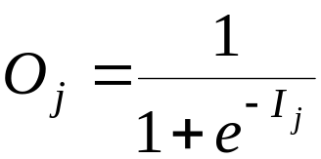
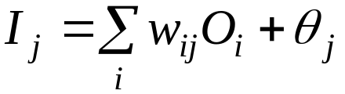
Multi-Layer Perceptron
Output vector
Output nodes
Hidden nodes
w_{ij}
Input nodes
Input vector: x_{i}

Slide 30
Network Pruning and Rule Extraction
Network pruning
  Fully connected network will be hard to articulate
  N input nodes, h hidden nodes and m output nodes lead to h(m+N) weights
  Pruning: Remove some of the links without affecting classification accuracy of the network
Extracting rules from a trained network
  Discretize activation values; replace individual activation value by the cluster average maintaining the network accuracy
  Enumerate the output from the discretized activation values to find rules between activation value and output
  Find the relationship between the input and activation value
  Combine the above two to have rules relating the output to input
Notes:
Ranjana vyas

Slide 31
ANN Paradigm & Deep Learning
In deep learning, a convolutional neural network (CNN, or ConvNet) is a class of deep neural networks, most commonly applied to analyzing visual imagery

Slide 32
Conventional Vs Deep Learning
Conventional machine-learning techniques were limited in their ability to process natural data in their raw form.
For decades, constructing a pattern-recognition or machine-learning system required careful engineering and considerable domain expertise to design a fea- ture extractor that transformed the raw data (such as the pixel values of an image) into a suitable internal representation or feature vector from which the learning subsystem, often a classifier, could detect or classify patterns in the input.

Slide 33
Representational learning
Representation learning is a set of methods that allows a machine to be fed with raw data and to automatically discover the representations needed for detection or classification.
Deep-learning methods are representation-learning methods with multiple levels of representa- tion, obtained by composing simple but non-linear modules that each transform the representation at one level (starting with the raw input) into a representation at a higher, slightly more abstract level.
With the composition of enough such transformations, very complex functions can be learned. For classification tasks, higher layers of representation amplify aspects of the input that are important for discrimination and suppress irrelevant variations.
  An image, for example, comes in the form of an array of pixel values, and the learned features in the first layer of representation typically represent the presence or absence of edges at particular orientations and locations in the image. The second layer typically detects motifs by spotting particular arrangements of edges, regardless of small variations in the edge positions. The third layer may assemble motifs into larger combinations that correspond to parts of familiar objects, and subsequent layers would detect objects as combinations of these parts. The key aspect of deep learning is that these layers of features are not designed by human engineers: they are learned from data using a general-purpose learning procedure.

Slide 34
Deep Learning
Deep learning is making major advances in solving problems that have resisted the best attempts of the artificial intelligence commu- nity for many years. It has turned out to be very good at discovering intricate structures in high-dimensional data and is therefore applica- ble to many domains of science, business and government. In addition
It is belived that deep learning will have many more successes in the near future because it requires very little engineering by hand, so it can easily take advantage of increases in the amount of available com- putation and data. New learning algorithms and architectures that are currently being developed for deep neural networks will only accelerate this progress.

Slide 35
Supervised learning
The most common form of machine learning, deep or not, is supervised learning. Imagine that we want to build a system that can classify images as containing, say, a house, a car, a person or a pet.
We first collect a large data set of images of houses, cars, people and pets, each labelled with its category.
During training, the machine is shown an image and produces an output in the form of a vector of scores, one for each category. We want the desired category to have the highest score of all categories, but this is unlikely to happen before training. We compute an objective function that measures the error (or distance) between the output scores and the desired pattern of scores.

Slide 36
Deep Learning in Supervised learning
The machine then modifies its internal adjustable parameters to reduce this error. These adjustable parameters, often called weights, are real numbers that can be seen as ‘knobs’ that define the input–output func- tion of the machine. In a typical deep-learning system, there may be hundreds of millions of these adjustable weights, and hundreds of millions of labelled examples with which to train the machine.
To properly adjust the weight vector, the learning algorithm computes a gradient vector that, for each weight, indicates by what amount the error would increase or decrease if the weight were increased by a tiny amount. The weight vector is then adjusted in the opposite direction to the gradient vector.

Slide 37
Deep Learning & CNN
CNNs use a variation of multilayer perceptrons designed to require minimal preprocessing.
in 1998, Convolutional Neural Networks were introduced in a paper by Bengio, Le Cun, Bottou and Haffner. Their first Convolutional Neural Network was called LeNet-5 and was able to classify digits from hand-written numbers.
Convolutional Neural Networks have a different architecture than regular Neural Networks.
  Regular Neural Networks transform an input by putting it through a series of hidden layers. Every layer is made up of a set of neurons, where each layer is fully connected to all neurons in the layer before. Finally, there is a last fully-connected layer — the output layer — that represent the predictions.

Slide 38
Convolution in CNN
Convolution is one of the main building blocks of a CNN. The term convolution refers to the mathematical combination of two functions to produce a third function. It merges two sets of information.
In the case of a CNN, the convolution is performed on the input data with the use of a filter or kernel (these terms are used interchangeably) to then produce a feature map.

Slide 39
Convolutional Neural Networks have different architecture.
First of all, the layers are organised in 3 dimensions: width, height and depth.
Further, the neurons in one layer do not connect to all the neurons in the next layer but only to a small region of it.
Lastly, the final output will be reduced to a single vector of probability scores, organized along the depth dimension.

Slide 40
Bibliography
J. Han and M. Kamber. Data Mining – Concepts and Techniques. 2001. Morgan Kaufmann.
M. Kantardzic. Data Mining – Concepts, Models, Methods, and Algorithms. 2003. IEEE.
M. H. Dunham. Data Mining – Introductory and Advanced Topics.
I.H. Witten and E. Frank. Data Mining – Practical Machine Learning Tools and Techniques with Java Implementations. 2000. Morgan Kaufmann.
Ranjana Vyas- Ph.D. Thesis “ Exploring some data mining techniques for DSS through efficient Knowledge Management” 2008.
Fall 2003
CSE 494 by H. Liu

